Slide 1
SC1015 Mini Project
Randall Cher
Lim Qi Le
14/04/2022
Movie Recommendation
#1
Notes:
10 min video presentation

Slide 2
Motivation
Problem Definition
Many of us have been stuck at home due to the Covid-19 pandemic, and we often wonder what shows to watch
How can we find movies that are similar to those that we enjoyed watching?

Slide 3
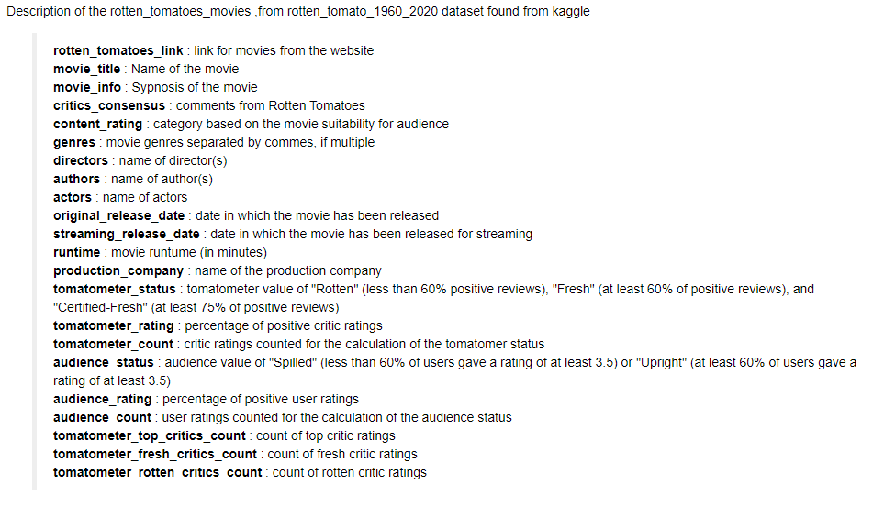

Movie Dataset
What we would need to find similar movies
Retrieved from Kaggle:
https://www.kaggle.com/datasets/stefanoleone992/rotten-tomatoes-movies-and-critic-reviews-dataset?select=rotten_tomatoes_movies.csv

Slide 4
Cleaning up the dataset
01

Slide 5
Movies without a description
As can be seen, not all movies have movie_info
We will drop these movies from the dataframe
Notes:
There are 17712

Slide 6
Utilise text clustering
02

Slide 7
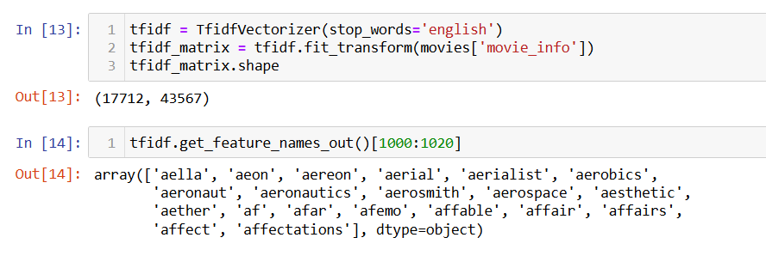
TF-IDF Vectorizer
Evaluate the relevance/importance of a word in a document in a collection of documents
Inverse document frequency - words that appear more frequently have less weight placed on them
Term frequency - frequency of a term within a document

Slide 8
Similarity function
03

Slide 9
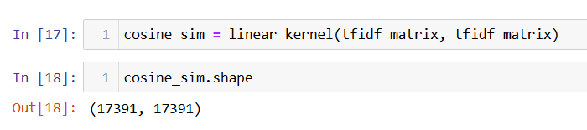
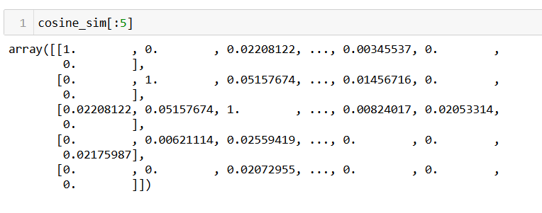
Cosine Similarity
Calculate the similarity between two movies
linear_kernel function as the dot product between each vector will give us the cosine similarity score

Slide 10
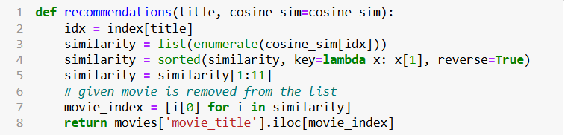
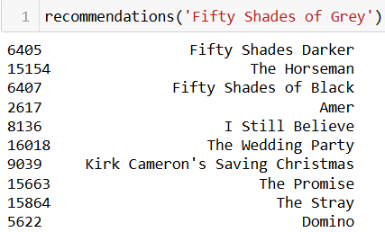
Recommendation
User will input a movie which he/she enjoyed watching
10 movies that are most similar to the movie will be recommended

Slide 11
Improving the recommendation parameters

Slide 12
Identifying parameters
04

Slide 13
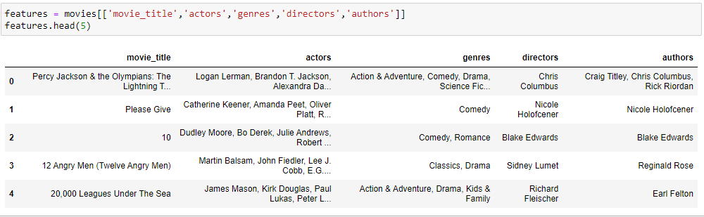
More parameters
Other parameters that could be used
In the above section, we only used one factor to provide recommendations
Recommendations can be improved by utilising more of the data, such as actors, genres, directors and authors

Slide 14
Create Soup
05
Combining the other parameters

Slide 15
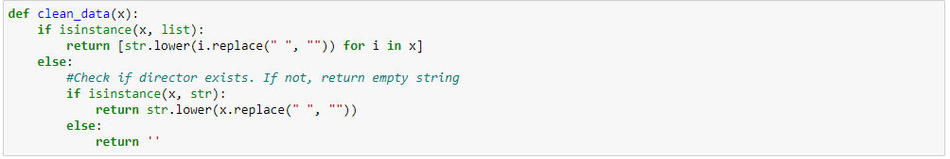
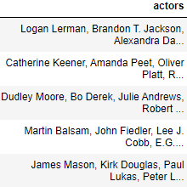
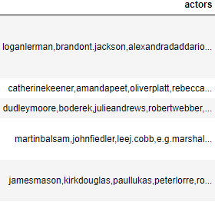
Cleaning the dataset
Remove spaces from names
Convert all strings to lower-case

Slide 16

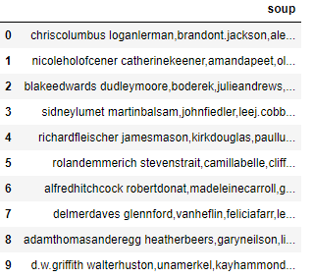
Create soup
Combines different categories into a single string
Notes:
Output of this function is fed into the word vector model

Slide 17


Cosine Similarity
Use of CountVectorizer
Calculate similarity using cosine_similarity function

Slide 18
Conclusion
06
Notes:
Never utilise ratings to recommend

Slide 19
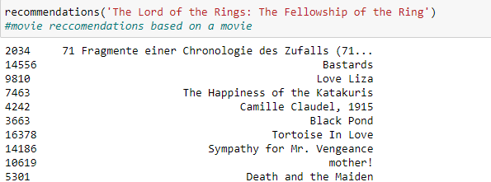
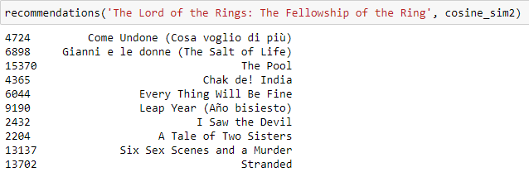
Results
Plot Similarities
Authors, Actors, Directors and Genres
2nd recommender captures more information for recommendations

Slide 20
Improvements
Other factors
Popularity Filter
Different Weightage
Reviews
Production Company
Sort movies
Recommend highest rated
Certain categories can have higher weightage

Slide 21
Thank you!

